Slide 1
FINCAP POC

Slide 2
FINCAP existing architecture
Build on MVC architecture
Views are built using model
Both business logic and presentation logic will present on server side
Couldn’t not replace only backend to open source technologies
Need to separate the presentation layer to replace only backend

Slide 3
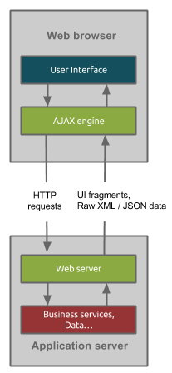
FINCAP existing architecture

Slide 4
FINCAP Proposed Architecture
Building the new backend application using MVVM architecture to serve only the business data
All presentation logic will bring to client side
Clear separation of presentation layer and business layer
Loosely coupled layers for easy adoption of new technology
Parallelly and Independently teams can work

Slide 5
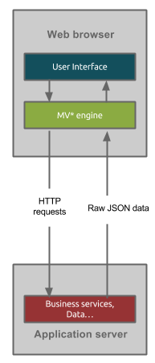
FINCAP Proposed Architecture

Slide 6
Open source Technologies
Programming Language - Java
Framework – Spring
Web services – Spring Restful web services
Client side framework – Angular

Slide 7
POC- CAR Hedge Processing
Building new application using proposed technologies for CAR Hedge Processing as a POC
Uploading file, importing data and processing data with minimal/required operations.

Slide 8
Plan & Timeline
Building the base application – 8 days
Creating Master layout for CAR Hedge processing – 5 days
File upload functionality – 2 days
Displaying list of connections – 2 days
File import to staging table – 3 days
Writing stored procedure for processing imported data - ?
Record editing – 4 days

